Slide 1
West Nile Fever
Assist. Prof. Dr. Hussein Al Naji

Slide 2
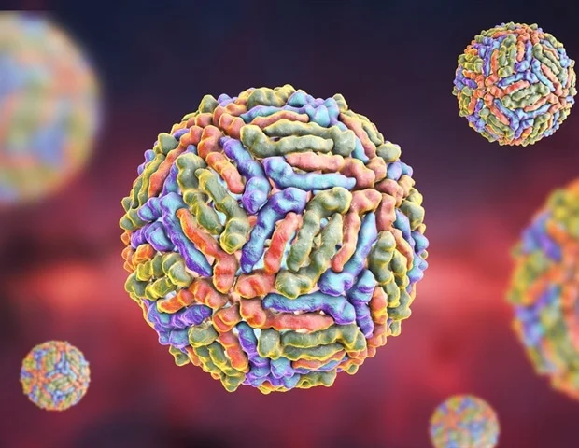
NOTE:
To change images on this slide, select a picture and delete it. Then click the Insert Picture icon
in the placeholder to insert your own image.
West Nile fever is a disease caused by West Nile Virus (WNV), which is a flavivirus related to the viruses that cause St. Louis encephalitis, Japanese encephalitis, and yellow fever. It causes disease in humans, horses, and several species of birds. Most infected individuals show few signs of illness, but some develop severe neurological illness which can be fatal. West Nile Virus has an extremely broad host range. It replicates in birds, reptiles, amphibians, mammals, mosquitoes and ticks.

Slide 3
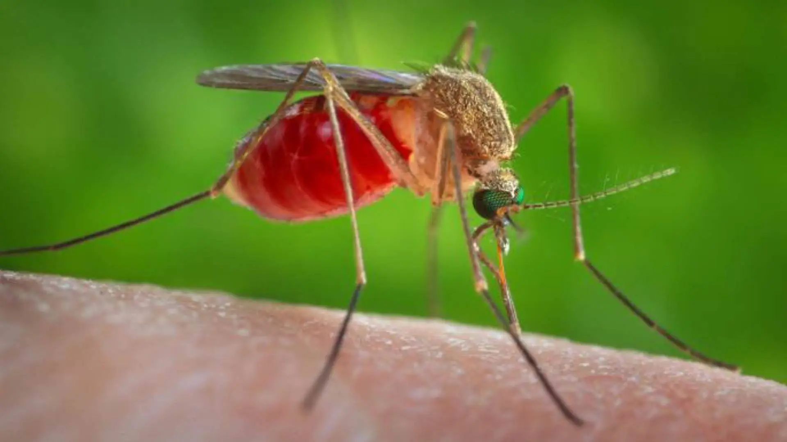
Transmission and spread
Infected mosquitos transmit West Nile virus. They usually get the virus by biting an infected bird (there’s no evidence humans get it directly from birds). The virus multiplies inside the mosquito, and it’s transmitted to you (or another animal) when it bites you.
The incubation period is usually two to six days after getting bitten (but can be up to 14 days).
In a very few cases, West Nile virus has spread:
A- From a pregnant person to their fetus.
B- Through human milk.
C- Through a blood transfusion.
D- Through an organ transplant.

Slide 4
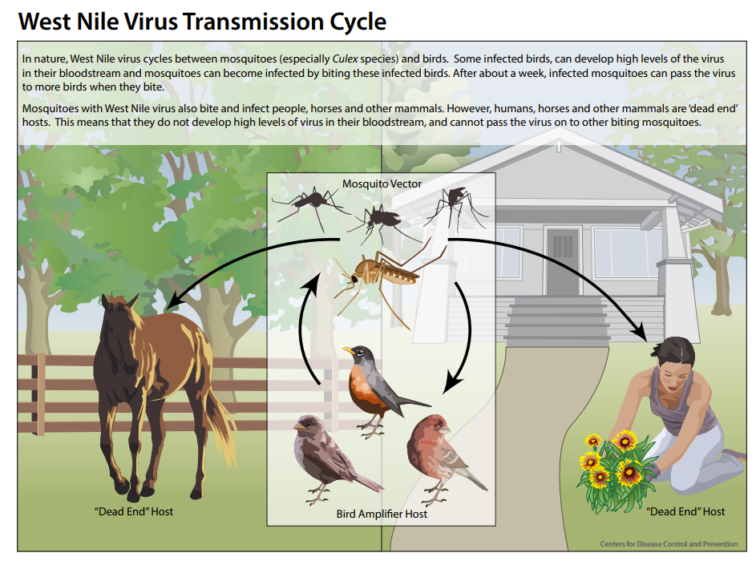

Slide 5
Note: West Nile isn’t contagious. You can’t get it from another person who has it.
What are the risk factors for West Nile fever?
1- Mosquitos can bite anyone. But certain people are at a higher risk of getting severely ill if they get West Nile. You might be at a higher risk if you:
2- over the age of 60.
3- an organ transplant recipient.
4- Have cancer.
5- Have diabetes.
6- Have high blood pressure (hypertension).
7- Have kidney disease

Slide 6
Clinical signs
West Nile fever is primarily a disease of humans, equines and some birds.
In horses, clinical signs of the neurologic disease caused by West Nile Virus may include loss of appetite, depression, stumbling, muscle twitching, partial paralysis, impaired vision, head pressing, teeth grinding, aimless wandering, convulsions, circling, and an inability to swallow. Weakness, usually in the hind limbs, is sometimes followed by paralysis. Coma and death may occur. Fever has been seen in some but not all cases.
In Human are susceptible to the disease, however most have no symptoms. About twenty percent have mild flu-like symptoms of fever, headaches and rashes.

Slide 7
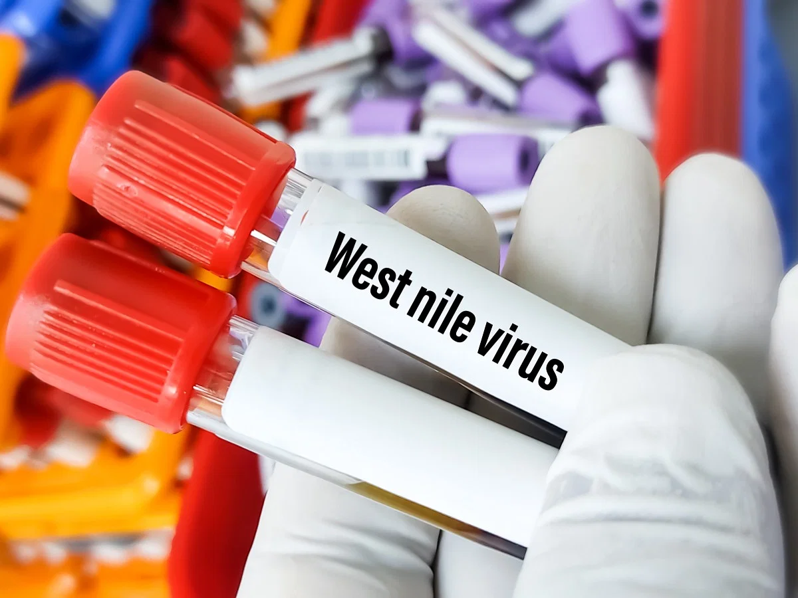
Diagnosis and Tests
1- A provider can test your blood or cerebrospinal fluid (CSF) to look for antibodies or other signs of a West Nile virus infection.
2- If you have signs of brain inflammation, they’ll get images of your brain with a CT scan (computed tomography scan) or MRI (magnetic resonance imaging).

Slide 8
Prevention and control
1- Key to preventing the spread of West Nile fever is to control mosquito populations.
2- Horses should be protected from exposure to mosquitoes. Likewise, people should avoid exposure to mosquitoes especially at dusk and dawn when they are most active, use insect screens and insect repellents, and limit places for mosquitoes to breed.
3- There is a vaccine for horses.
Surveillance programmes in wild or sentinel birds allow the competent authorities to take appropriate measures to protect animals and people.
As birds in the crow family are very susceptible, these programmes often encourage people to report dead crows for testing.

Slide 9
THANK YOU

